Slide 1


Department of Computer Science and Engineering
BLOCKCHAIN BASED SECURE DATA TRANSFER IN CLOUD STORAGE
ABITHA U [211419104004]
KAVIASREE S [211419104129]
PHOOJA SHREE R [211419104189]
Guide Name
Dr. K. Sangeetha, M.E., Ph.D.,
Coordinator Name
Dr. Kavitha Subramani, M.E., Ph.D.,
1

Slide 2
Abstract
The growth in technological advancements has led to the abrupt rise in the improvement of digital belongings and transactions. The documents or files are more prone to information breaches and theft from the intruders who are successful in obtaining the data. In this work, we describe a security system that protects sensitive data. Compared to traditional physical storage, cloud storage offers a number of advantages, including more readily available data storage. You may exchange files and collaborate with others effortlessly using the cloud. A blockchain is a type of digital database that can hold a tonne of data. One of the secure information technologies that is developing quickly and aids in giving data security is blockchain. Data that has been initialized by the user cannot be edited or exchanged, which gives user data an ever-increasing level of protection. Along with the blockchain approaches, AES encryption and decryption algorithm is implemented in this project. The process of encryption turns the original data into an unrecognizably altered state. The private data will be secure as a result. The hash code algorithm is also used such as SHA-256. SHA-256 is secure and has not been "broken," which is the main reason why technology employs it. So the data stored in the cloud is more secured and the data security against malicious activity is carried out by examining the authorized users IP address and email.

Slide 3
Literature Survey
Year | Author | Paper Details | Methodology | Merits | Demerits
2021 | Adam Bowers, Cong Liao, Douglas Steiert , Dan Lin , Anna Squicciarini, and Ali Hurson | TITLE: Detecting Suspicious File Migration or Replication in the Cloud VOLUME: 18 ISSUE:1 JOURNAL: IEEE | The technique used is LAST-HDFS which integrates Location-Aware Storage Technique (LAST) into the open source Hadoop Distributed File System (HDFS). | It is capable of detecting potential illegal transfers which moves sensitive data outside the boundaries specified by the file owner. | It may lead to malicious activities in various ways, such data will be known by unknown users, data or file maybe lost.

Slide 4
Literature Survey
Year | Author | Paper Details | Methodology | Merits | Demerits
2022 | Anusree K, Jagan Sathiaseelan Vadekkat, Abhinu R Dev, Abhinav | TITLE: Decentralized File Transfer System Blockchain-based File Transfer VOLUME: 11 ISSUE:5 JOURNAL: IJERT | The purpose is to solve the need for blockchain applications to exchange larger files with sensitive information within an organization using Inter Planetary File System (IPFS). | The goal of this system is to use the blockchain concept to promote file sharing services with greater security and lower risk. | Any valid user connected with organizations network can check other users rights for the file they are sharing which makes no privacy to the user’s

Slide 5
Literature Survey
Year | Author | Paper Details | Methodology | Merits | Demerits
2020 | Anjaly Renny , Anjana Santhosh , Neeraja S, Teena Noyal | TITLE: File Storing and Sharing using Blockchain VOLUME: 9 ISSUE: 6 JOURNAL: IJIRSET | The File Storing and Sharing is done using Blockchain and AES algorithm. | It is much secure, efficient and effective in sharing of file. | Suspicious activities like unauthorized user login and accessing of data may occur.

Slide 6
Literature Survey
Year | Author | Paper Details | Methodology | Merits | Demerits
2018 | Mathis Steichen, Beltran Fiz, Robert Norvill, Wazen Shbair and Radu | TITLE: Blockchain-Based, Decentralized Access Control for IPFS CONFERENCE: IEEE | This paper presents a modified version of the InterPlanetary Filesystem (IPFS) that leverages Ethereum smart contracts to provide access controlled file sharing. The smart contract is used to maintain the access control list, while the modified IPFS software enforces it. | Users can efficiently share large files and still benefit from the blockchain. | The particular file requested by different user is accessed by one user based on the priority of the request.

Slide 7
Problem Statement
In this project, we examine how the data source is managed throughout the organization. The main objective of this project is to ensure the safety measures against the security breach. Technology developments have generated enormous amounts of data, including sensitive and personal information. These days, there are many security issues, including difficulties with access control, scalability, virtualization, privacy, and massive data processing. One of the most popular technology for data security is blockchain. The sensitive files are first converted to fixed-sized blocks of data that are then encrypted using modified AES and SHA-256, taking into account the instance of a company or organization. IP addresses are utilized in such a way that they are checked for each action.

Slide 8
Proposed System
The Proposed System considers an organization into account where the input file or data which a project manager or any other employee in a particular organization needs to share with others in the organization is converted into fixed-sized blocks of data, which is similar to the concept used in blockchain.
Here the manager browses and adds different files for each section of employees with different access rights, so the employee with the respective access right (valid organization IP address) could request for the file.
The approach not only ensures confidentiality and integrity of files, but also provides a scalable key management mechanism for file sharing among multiple users.
After checking the requests by authority person, if the user is valid, then the user can get the response through mail and if the user is not valid then their request will be rejected.

Slide 9
Software / Hardware used
Software Requirements:
Operating System : Windows 10
Programming Language : Java
Ide : Eclipse
Front End : HTML, CSS, JSP
Back End : My SQL 5.5
Hardware requirements:
Processor : Core i5 Processor
Hard disk : 250 GB
RAM : 4 GB

Slide 10
Methodology used
Algorithms Used:
Advanced Encryption Standard (AES) Algorithm
Secure Hash Algorithm (SHA-256) Algorithm

Slide 11
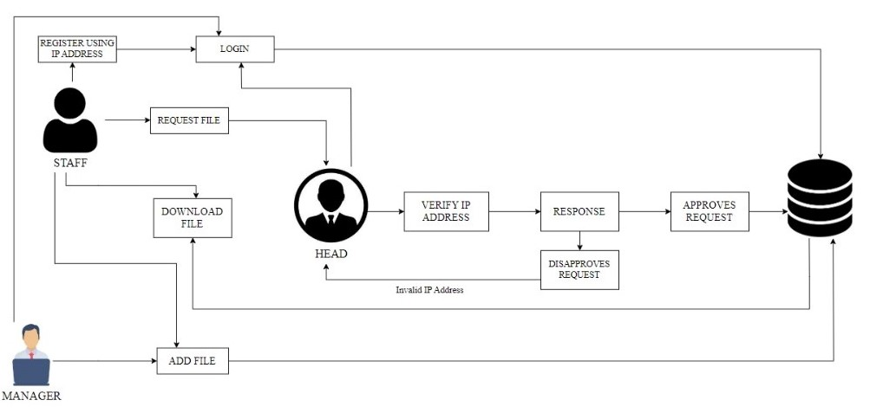
System Architecture

Slide 12
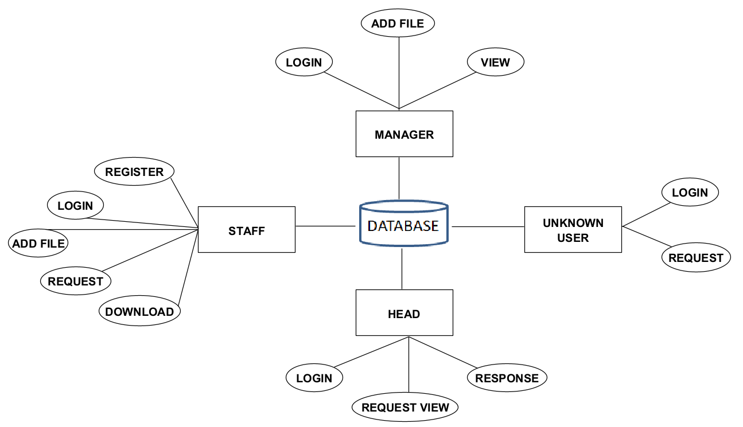
System Design – ER Diagram

Slide 13
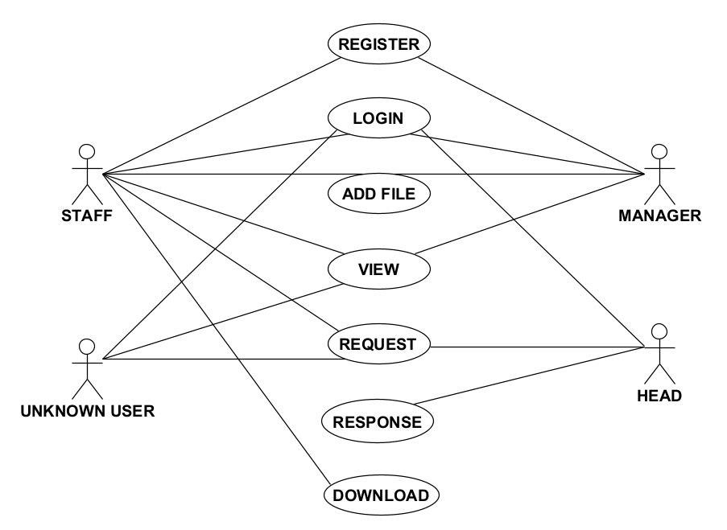
System Design – Use Case Diagram

Slide 14
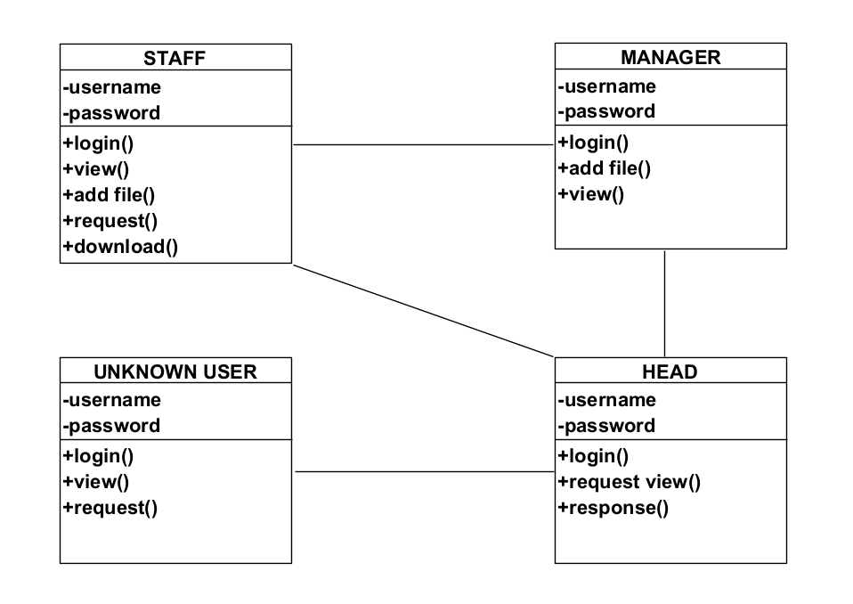
System Design – Class Diagram

Slide 15
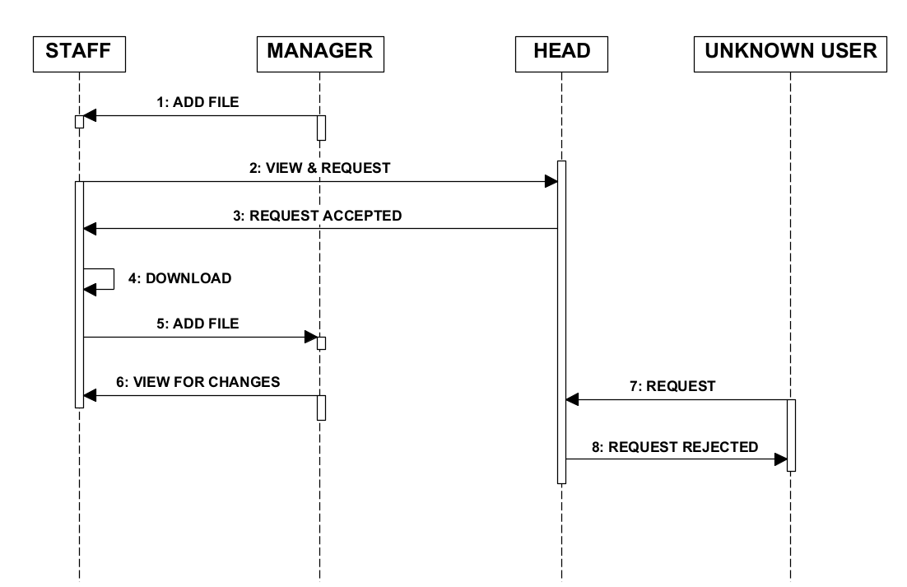
System Design – Sequence diagram

Slide 16
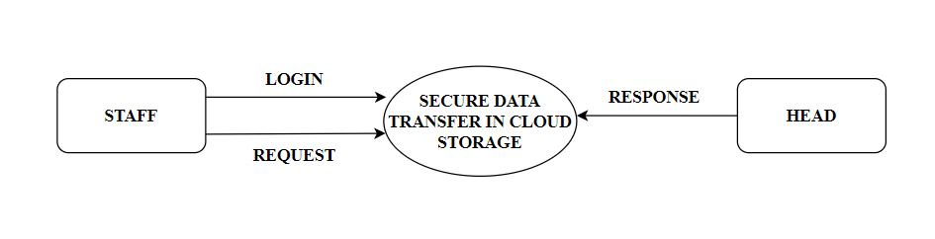
System Design – DF Diagram
LEVEL 0 DFD DIAGRAM

Slide 17
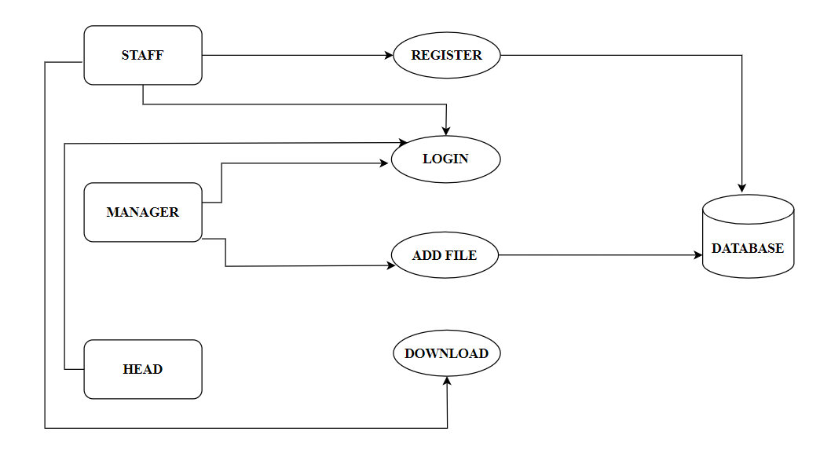
System Design – DF Diagram
LEVEL 1 DFD DIAGRAM

Slide 18
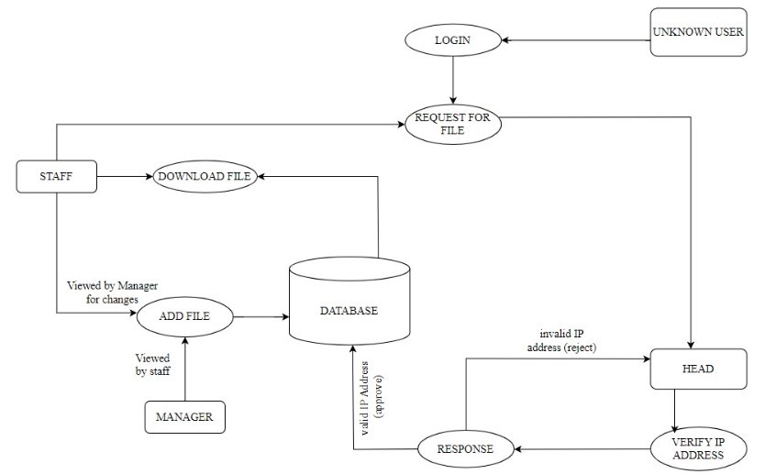
System Design – DF Diagram
LEVEL 2 DFD DIAGRAM

Slide 19
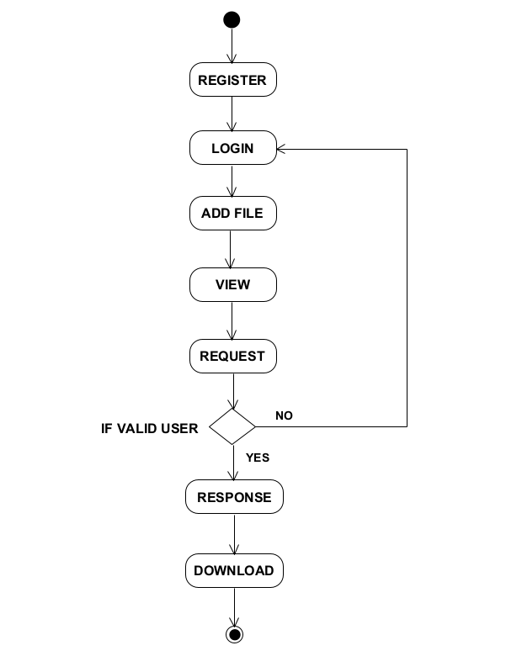
System Design – Activity diagram

Slide 20
Module Description
STAFF:
Staff Register:
The Register module gives a reasonable structure to enter information on those staff who are new to the organization. They need to sign up/register to login the website. For registration this module requires valid input such as username, phone number, email id, password. The registration details that are filled by the staff are stored in the cloud storage.
Staff Login:
This module gives the way to enter into main page after login with valid input such as email id and password. The Login module is processed only if the login email id and password matches the data that are given during the registration.

Slide 21
Module Description
Staff File Request:
This module helps the staff, request the file stored in the cloud storage to the head and the head accept the request if the IP address is valid or else the request gets rejected if the IP address is invalid. This Request module is mainly based on the IP address of the device.
Staff File Download:
This module help the user to download the file after head approve the request. The file can be downloaded using Secret key. In this project we are using two secret key one is the secret key generated when the file is added and the other one is QR Code key.
Staff Add File:
In this module the staff adds the file to the cloud storage, which can be viewed only by the manager not by the other staff.

Slide 22
Module Description
2) MANAGER:
Manager Login:
This module gives the way to enter into main page after login with valid input such as email id and password.
Manager Add File:
In this module the manager adds the file to the cloud storage, which can be viewed by the staff.
Manager File View:
In this module the manager can view the file they have uploaded.

Slide 23
Module Description
3) HEAD:
Head Login:
This module gives the way to enter into main page after login with valid input such as email id and password.
Head Response:
This module helps the user requested file to be accepted by the head. And the unknown user or third party also request the file. But the unknown user request IP address will be verified by the head. If the IP address is valid then they will get accepted, if it is invalid then they will get rejected.

Slide 24
TESTCASES
MODULE NAME: STAFF
Test Case Id | Test Case Name | Input | Expected Output | Actual Output | Test Result (Pass/Fail)
TC01 | Registration | Username, Phone number, Email ID, Password, | User should be redirected to login page (Scr 1.2) | User should be redirected to login page (Scr 1.2) | Pass
TC02 | Login | Email, Password | Login Successful (Scr 1.3) | Login Successful (Scr 1.3) | Pass
TC03 | Request | File | Request sent to Head (Scr 1.4) | Request sent to Head (Scr 1.4) | Pass
TC04 | Download | File Key, QR Code Key | Downloaded Successfully (Scr 1.5) | Downloaded Successfully (Scr 1.5) | Pass

Slide 25
TESTCASES
MODULE NAME: MANAGER
Test Case Id | Test Case Name | Input | Expected Output | Actual Output | Test Result (Pass/Fail)
TC01 | Login | Email, Password | Login Successful (Scr 1.6) | Login Successful (Scr 1.6) | Pass
TC02 | Add File | File, Type | Uploaded Successfully (Scr 1.7) | Uploaded Successfully (Scr 1.7) | Pass
TC03 | View | View File | Available Files are shown (Scr 1.8) | Available Files are shown (Scr 1.8) | Pass

Slide 26
TESTCASES
MODULE NAME: HEAD
Test Case Id | Test Case Name | Input | Expected Output | Actual Output | Test Result (Pass/Fail)
TC01 | Login | Email, Password | Login Successful (Scr 1.9) | Login Successful (Scr 1.9) | Pass
TC02 | Response | Verify IP Address | Request Accepted (Scr 1.10) | Request Accepted (Scr 1.10) | Pass

Slide 27
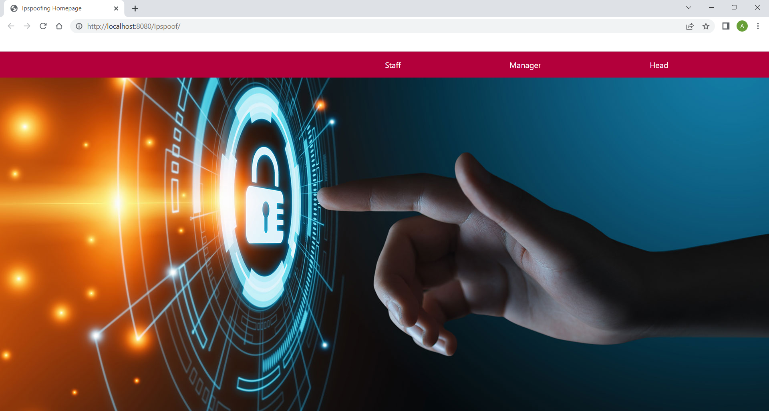
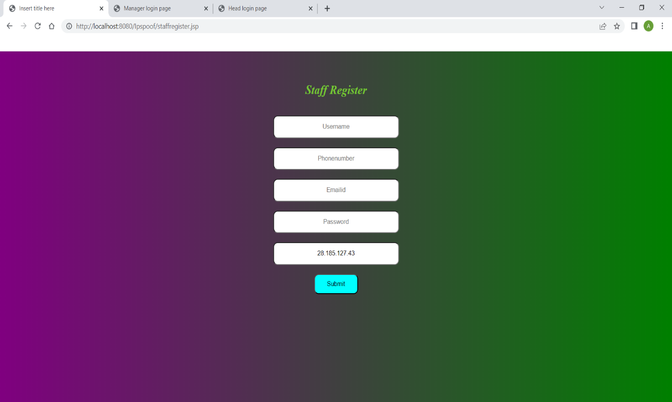
Screen Shots
Scr 1.1 Homepage page
Scr 1.2 Register page

Slide 28
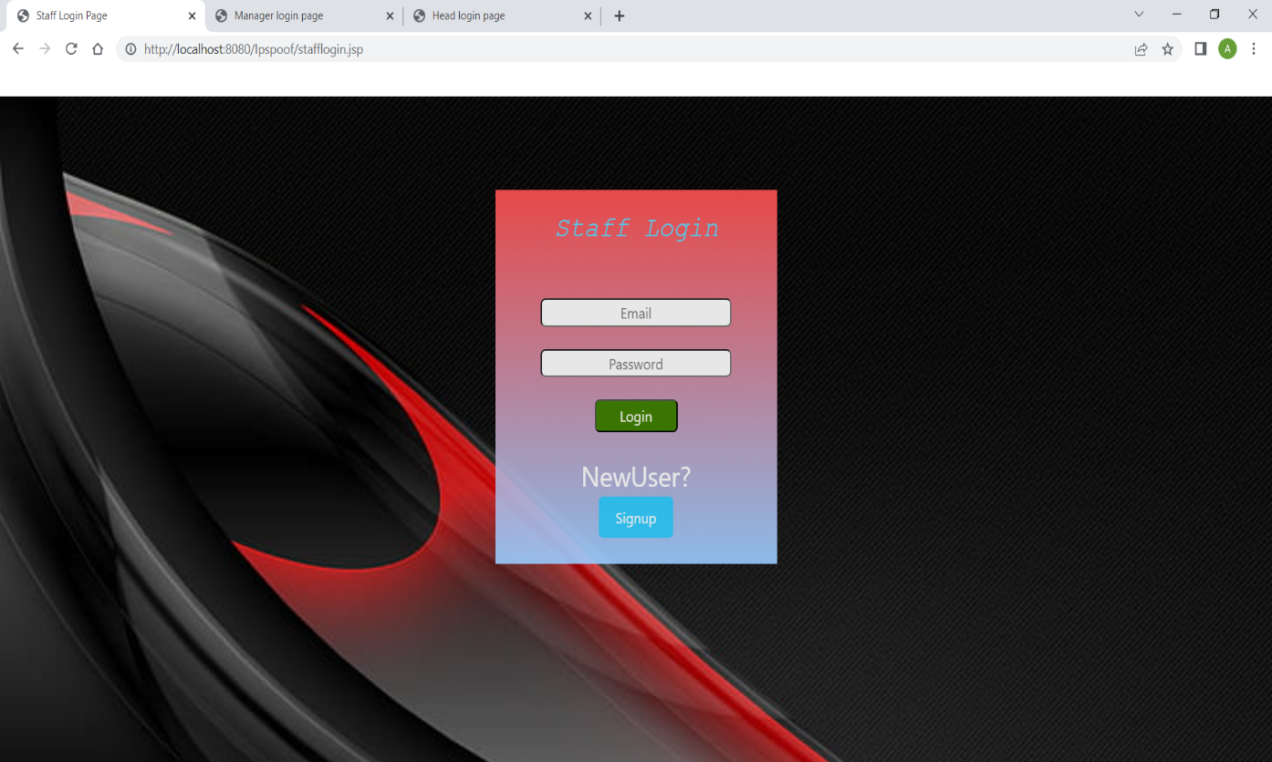
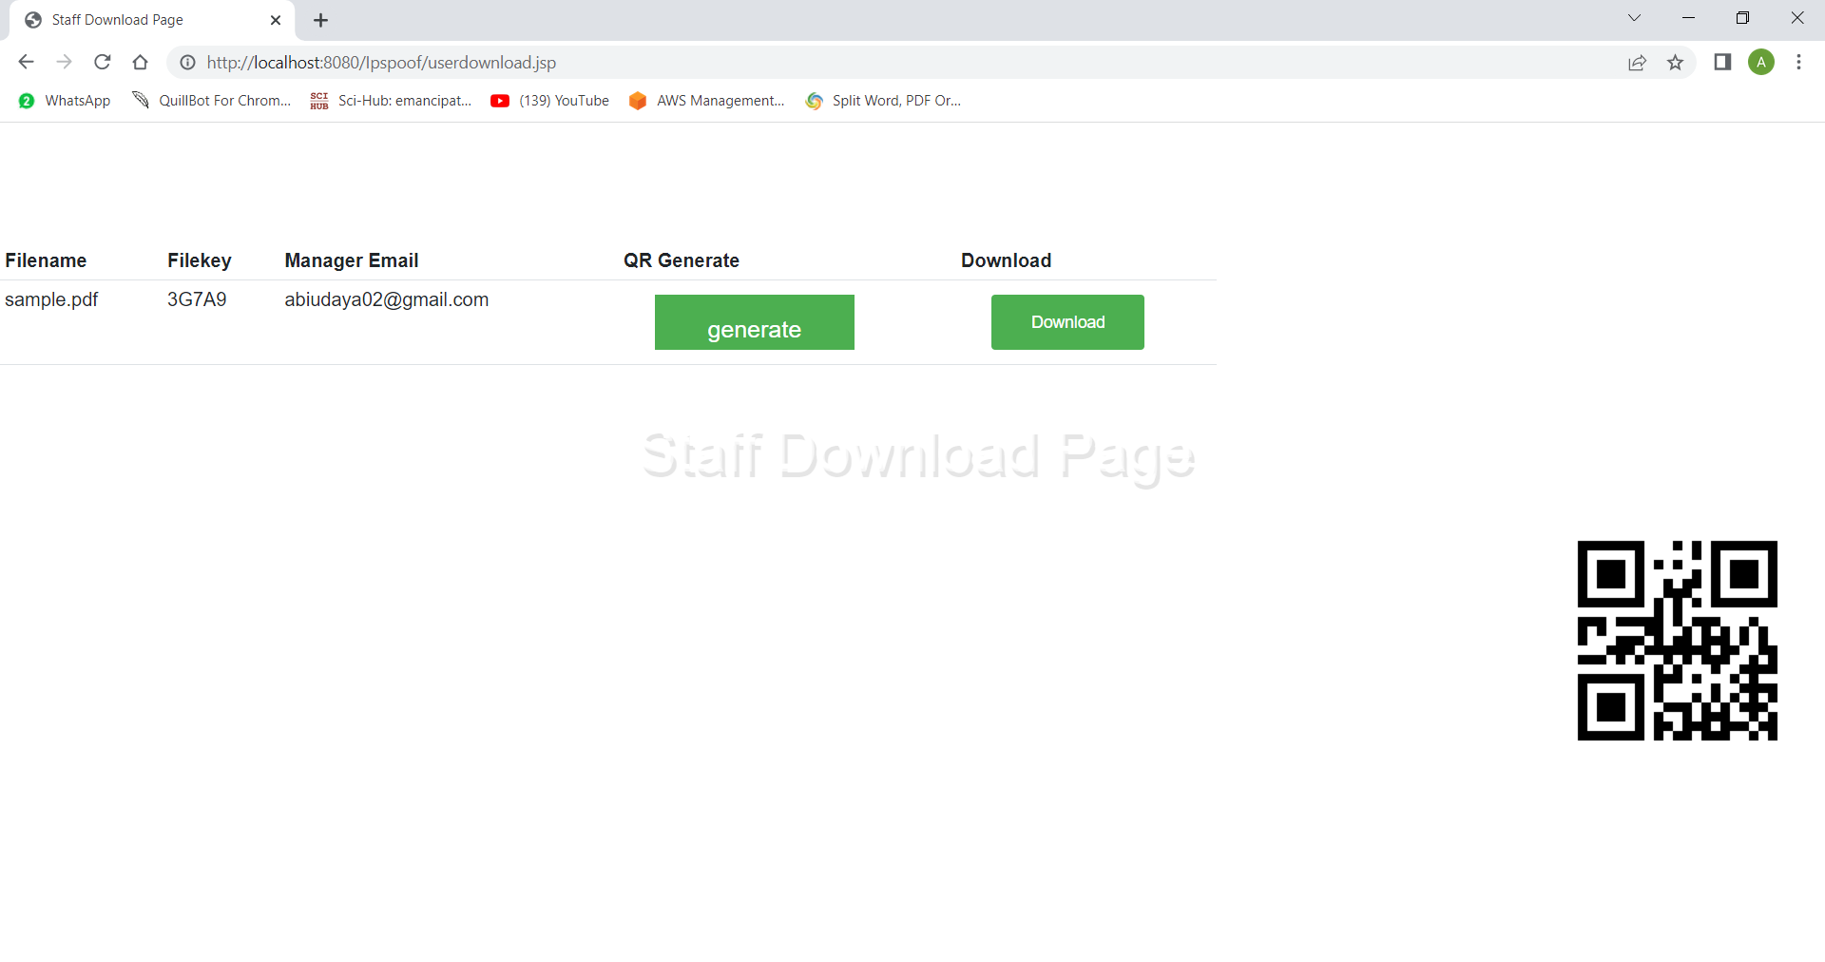
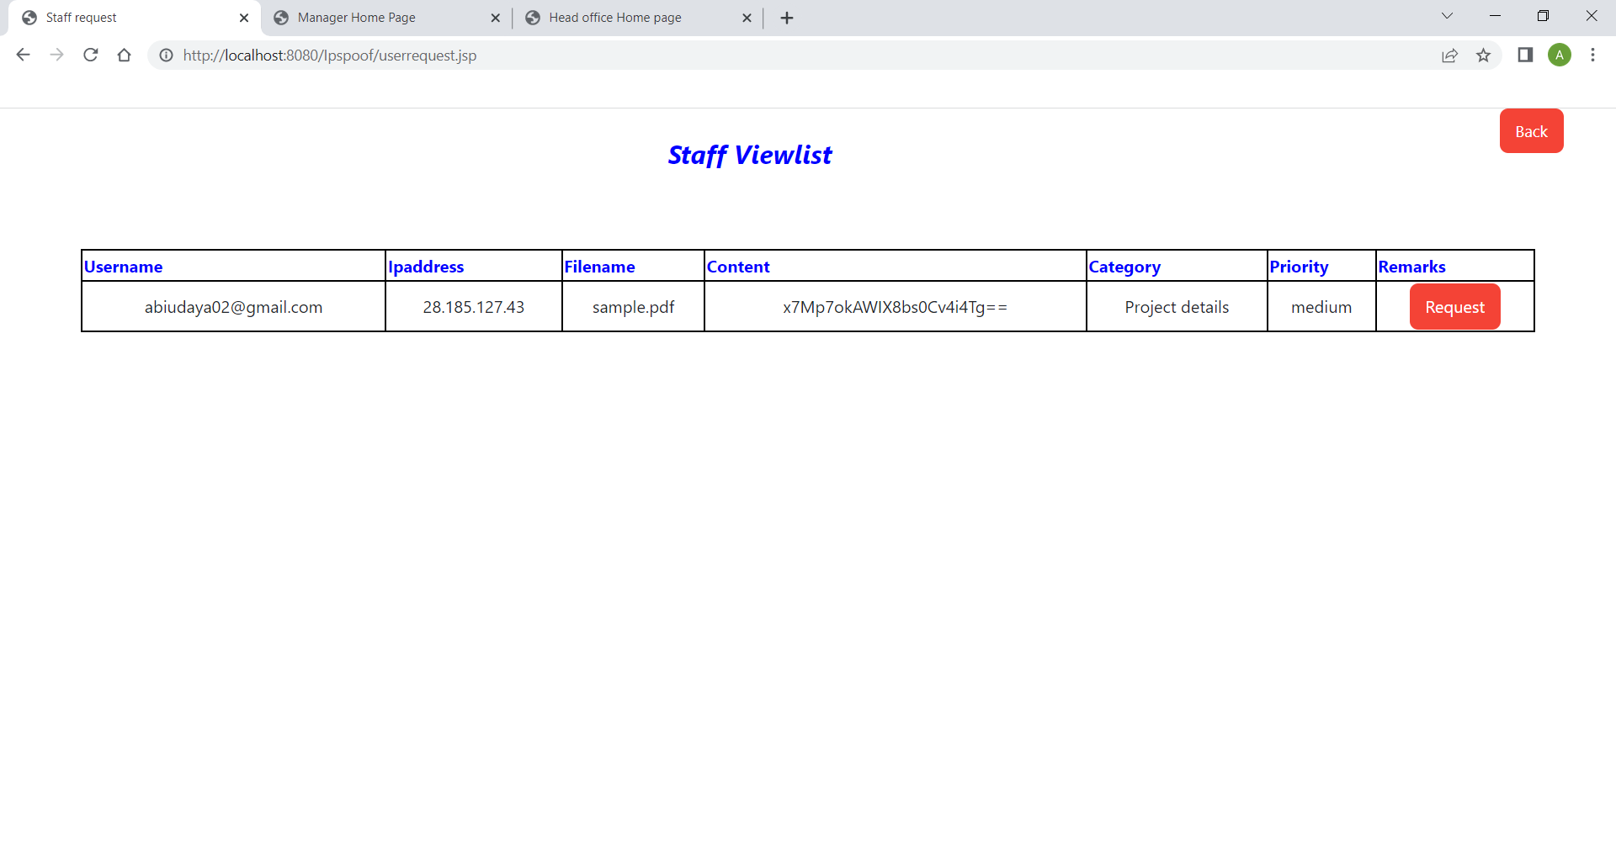
Screen Shots
Scr 1.3 Staff home page
Scr 1.4 Request page

Slide 29
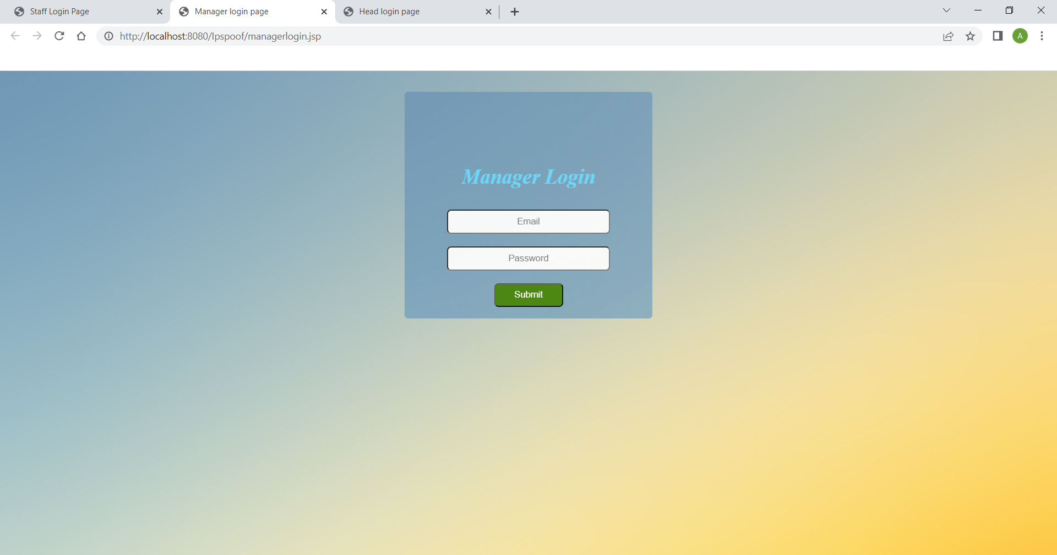
Screen Shots
Scr 1.5 Download page
Scr 1.6 Manager login page

Slide 30
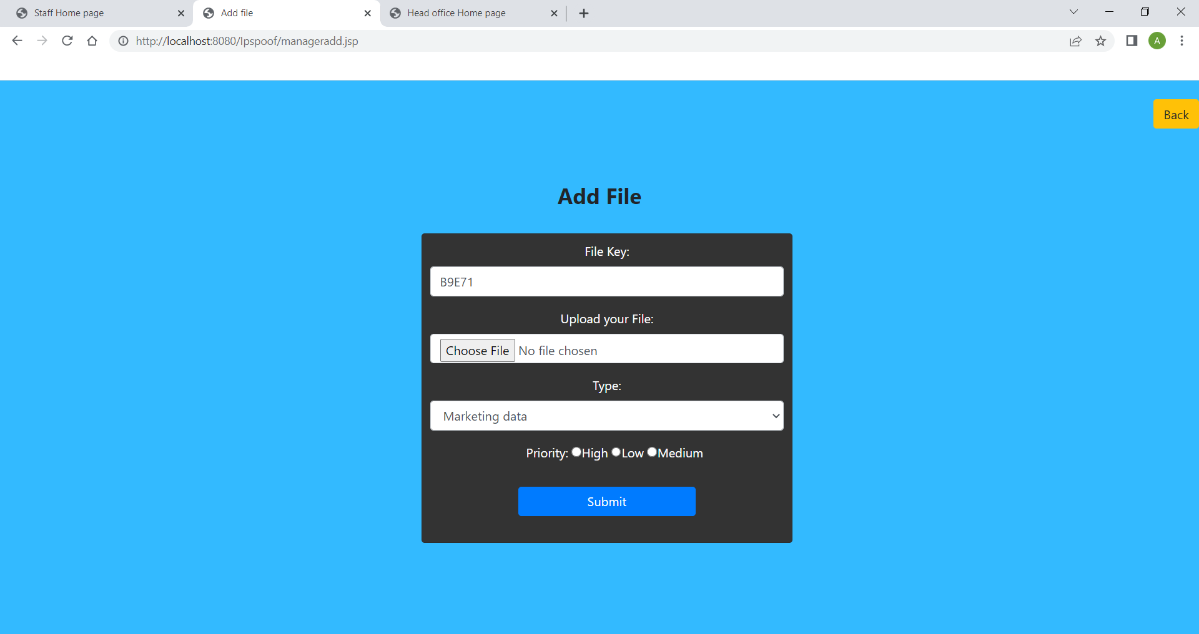
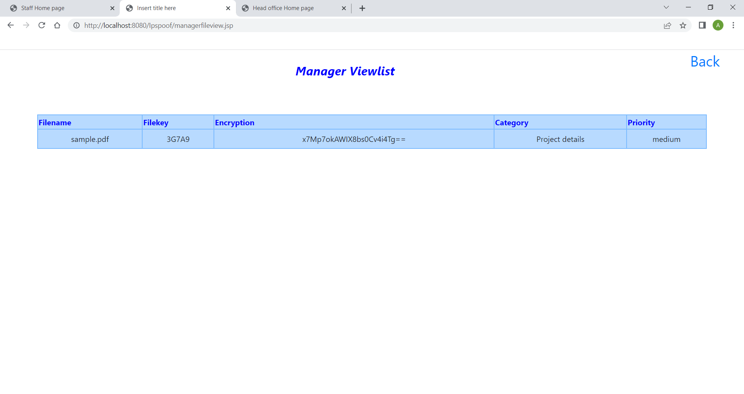
Screen Shots
Scr 1.7 Add file page
Scr 1.8 View page

Slide 31
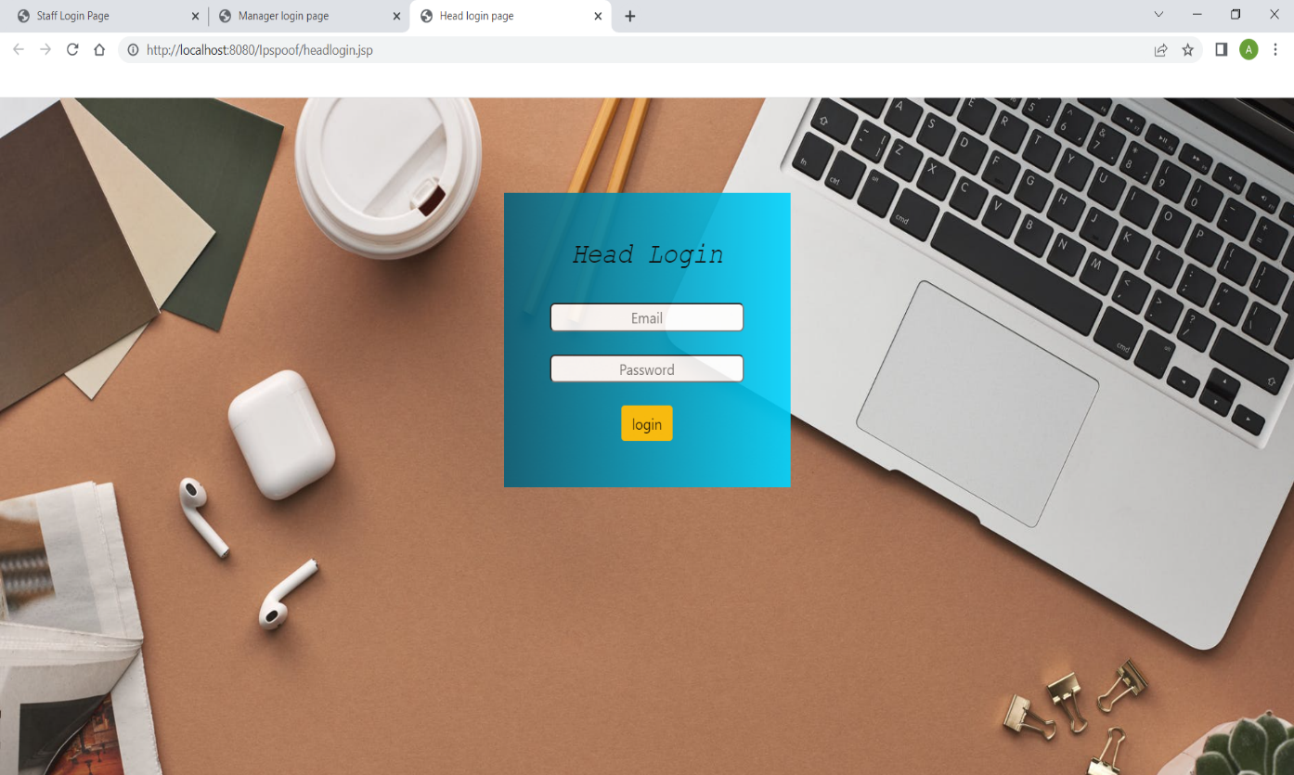
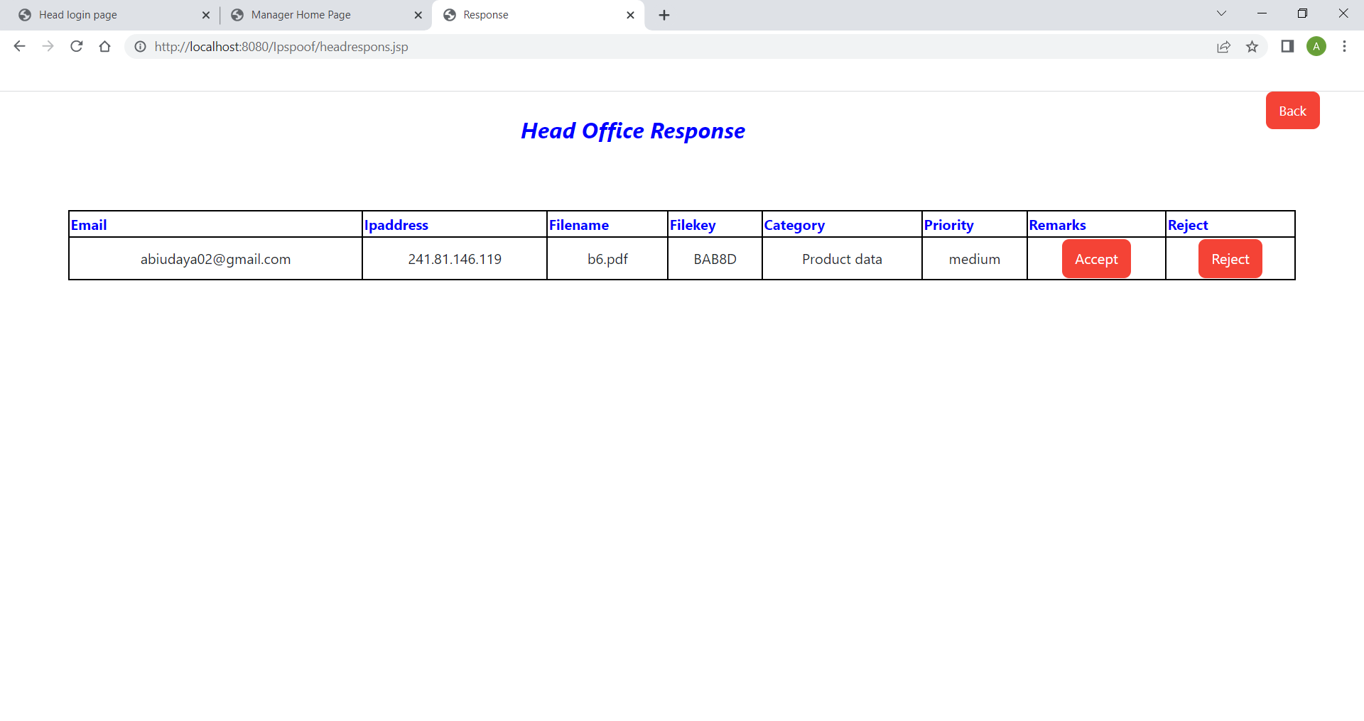
Screen Shots
Scr 1.9 Head login page
Scr 1.10 Response page

Slide 32
Conclusion / Feature Enhancement
Several sectors, including machine learning, banking, and the military, are utilizing blockchain, a new technology. Users share a significant amount of data daily. In this paper, we offered a more secure way to share files and store them on a reliable platform like blockchain. This technique can partially eliminate all the drawbacks of having a centralized network for sharing confidential files within an organization. Sensitive information needs to be shielded from unauthorized access. We looked into how blockchain addresses the challenging requirements of security, storage, sharing, and authentication when examining data. Cloud storage with blockchain technology seems to be a smart solution for business organization.

Slide 33
Reference Paper/ URL
Adam Bowers, Cong Liao, Douglas Steiert , Dan Lin , Anna Squicciarini, and Ali Hurson, “Detecting Suspicious File Migration or Replication in the Cloud”, 2021
Anusree K, Jagan Sathiaseelan Vadekkat, Abhinu R Dev, Abhinav, “Decentralized File Transfer System Blockchain-based File Transfer”, 2022
Devesh Solanki , Dev Mehta , Kaushal Modani, Sashank R M Dr Rashmi S, “An Android File Sharing System Using BlockChain & IPFS”, 2021
Jin Sun, Xiaomin Yao , Shangping Wang , and Ying Wu, “Blockchain-Based Secure Storage and Access Scheme For Electronic Medical Records in IPFS”, 2020
Anjaly Renny , Anjana Santhosh , Neeraja S, Teena Noyal, “File Storing and Sharing using Blockchain”, 2020

Slide 34
Reference Paper/ URL
Shujie Cui, Muhammad Rizwan Asghar, Giovanni Russello, ” Towards Blockchain - based Scalable and Trustworthy File Sharing”, 2018
Xiaochen Zheng, Raghava Rao Mukkamala, Ravi Vatrapu, Joaqun Ordieres-Mere, “Blockchain-based Personal Health Data Sharing System Using Cloud Storage ”, 2018
Mathis Steichen, Beltran Fiz, Robert Norvill, Wazen Shbair and Radu, “Blockchain-Based, Decentralized Access Control for IPFS ”, 2018
Hoang Giang Do, Wee Keong Ng, “Blockchain-based System for Secure Data Storage with Private Keyword Search”, 2017
Marlene Goncalves, Graciela Perera and Stephen Rodabaugh, “Detecting illegal file sharing in Peer-to-Peer networks using fuzzy queries”, 2010

